Slide 1
Building a SDN Enterprise WLAN Based On Virtual APs
Author: Luis Sequeira, Juan Luis de la Cruz, Jos´e Ruiz-Mas, Jose Saldana, Juli´an Fernandez-Navajas and Jos´e Almodovar
Publisher/Conference: IEEE Communications Letters
Presenter: Cheng-Feng Ke
Date: 2016/12/07
Department of Computer Science and Information Engineering
National Cheng Kung University, Taiwan R.O.C.
Notes:
1
利用 virtual ap 建立一個 SDN 的無線區域網路

Slide 2
Introduction
The scientific community is looking for proposals for inter AP coordination solutions enabling advanced features; e.g. load balancing, frequency planning or power control, while making use of low-cost hardware and open software.
Although commercial solutions exist, these are proprietary, closed and costly, which in most of the cases make them unfeasible for many organizations.
Notes:
這論文一開始是提到有需求是希望可以找一些 AP 之間協調的方案，目的是讓比較底階的硬體可以支援進階的功能，像是負載平衡、頻率規劃、功率控管。
雖然有一些商業的 solution 可以使用，但是都比較封閉而且昂貴，對很多組織來講不是一個好的方案。
所以希望透過 SDN 設計一個架構作無線網路的協調。
這裡協調的意思有點像是手機 3G 或 4G 網路的基地台，這些基地台的上面都會有一個 BSC 基地台控制器在管理，這個控制器會決定讓訊號比較好的基地台負責和手機的連線。

Slide 3
Introduction
In this letter the development and testing of an open enterprise Wi-Fi solution based on virtual APs, managed by a central WLAN controller is presented.
It allows seamless handovers between APs in different channels, maintaining the QoS of real-time services.
Notes:
所以這篇論文就是開發並測試一個基於 virtual ap 的無線區域網路架構，並透過集中式的 SDN controller 去管理。
這個架構會減少 client 在不同 ap 、不同 channel 轉換之間的延遲，來保持 real-time service 的品質。

Slide 4
Introduction
One of the first problems that arise when coordinating a wireless network is that the stations (STAs from now) have their own algorithms for selecting the AP.
Each STA is free to select the AP to associate, purely on the basis of local decisions, not coordinated with the rest of the clients. This complicates client management, and results in problems;
Other problem is that the normal handoff may incur a delay up to several hundreds of milliseconds [3]. This fact may not pose a big problem for certain services, but it may constitute a severe limitation for real-time applications as VoIP or online games.
Notes:
要作這個架構第一個遇到的問題就是每個 station 都會有他們自己選擇 AP 的演算法，在管理上就會有一定的難度。
還有另一個問題像是手機可能離開現在的 ap 的範圍，轉換和其他 ap 連線，這個過程可能發生幾百毫秒的延遲，
對一般看網頁或是聊天等等的應用比較沒有所謂，但對一些比較 real time 的 application 或是 online game 就會有比較大的影響。

Slide 5
Introduction
One way to solve these problems is the introduction of the Light Virtual Access Point (LVAP) abstraction, first proposed in [4].
The idea is that a physical AP will use a different LVAP (which includes a specific MAC) for communicating with each STA. Therefore, the STA will only “see” a single AP, even if it is actually moving between a set of them, thus avoiding the need for re-association.
Notes:
要解決上述問題，他有引用另外一篇論文提出的 LVAP 概念。
這個概念是在講不同的實體 AP 會透過 LVAP 和 STA 溝通，而 STA 在這個環境下則只會看見 Virtual AP，
在和 Virtual AP 連線的情況下，如果你遠離 AP1 靠近 AP2，則 STA 就會自動連接到和 AP2，而不用重新 assign ip 之類的資訊。

Slide 6
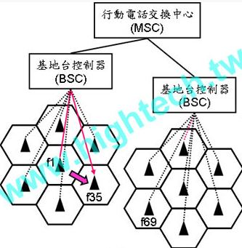
Introduction
It is dynamically assigned to a physical AP near the current location of the terminal. (handoff / handover)
Notes:
這個機制論文裡叫做 handoff 或 handover，中文好像叫做越區換手。
Handoff 這個字原本是被使用在手機 3G 4G 網路的基地台轉接上。
中間三角形的是基地台，f1 代表使用的 channel，使用者從這裡離開到這裡後會和 channel 是 f35 的基地台無縫連接。
上面的 BSC 基地台控制器會決定是否要進行 Handoff，這個圖和這篇論文要講的架構很像，只是基地台控制器這裡會換成 SDN 的 controller。

Slide 7
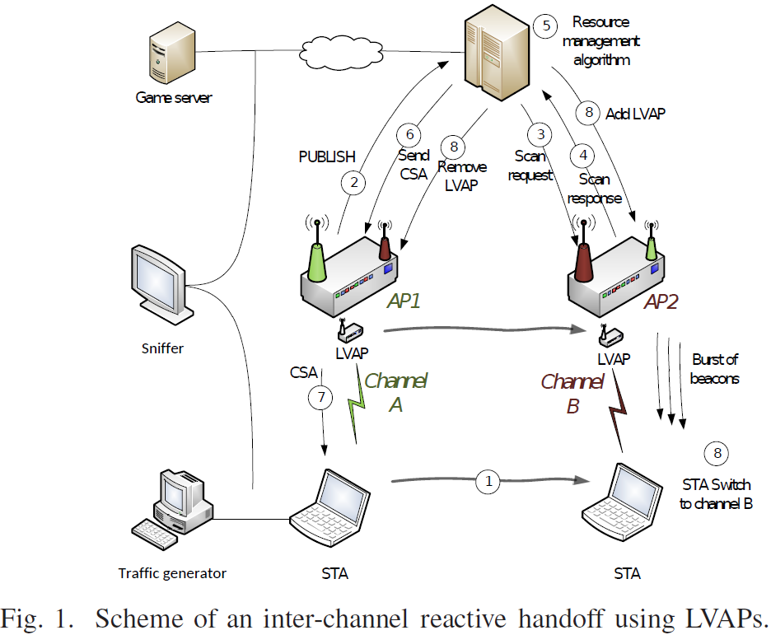
PROPOSED HANDOFF SCHEME

Slide 8
PROPOSED HANDOFF SCHEME
When the STA moves (1) away from the Origin AP (AP1 in channel A), it detects that the signal is below a threshold and sends a PUBLISH message to the controller (2).
According to its AP map, the controller sends a Scan Request message to the neighbor APs (3).
For a short period of time, all neighbor APs switch their auxiliary interfaces to channel A and listen to packets originated by the STA. If an AP successfully listens to the STA’s packets, it sends a Scan Response message to the controller (4).
Notes:
當 STA 遠離 AP1 時，AP1 會發現 STA 的訊號越來越遠，於是就向 Controller 發用 publish 的訊號。
Controller 收到訊號後，根據 AP map 發送 Sacn Request 訊號給靠近 AP1 的其他 AP。
接著所有臨近的 AP 都會切換輔助的接口 到 AP1 的 channel A ，如果有收到的 STA 的封包就傳送 Scan Response 的訊息給 controller。

Slide 9
PROPOSED HANDOFF SCHEME
Once the controller has received the Scan Response messages from the APs, it runs its algorithms (5) and selects the best suited one for the STA. The decision is: “move STA to AP2”.
The controller tells AP1 (6) to send a series of CSAs to the STA (7). They are understood by the STA like a countdown, meaning “after N beacons, switch to channel B”.
CSA (Channel Switch Announcement)
Beacon frames are transmitted periodically to announce the presence of a wireless.
Notes:
Controller 接收到 Scan Response 訊息後，根據 resource management 演算法選擇最適合的 AP，這裡先假設找到 AP2。
接著 controller 會讓 AP1 發送 CSA 訊息給 STA，要求 STA 在 N 個 beacons 之後切換 AP2 的 channel B。
CSA 訊息的作用就是要求 STA 切換 channel。
Beacon 就是指無線 AP 會發出的一種訊匡，它會週期性的告知網路裡有自己這個 AP 存在。

Slide 10
PROPOSED HANDOFF SCHEME
When the countdown ends, three events must occur in a specific order:
a) the STA switches to channel B (while AP1 does not);
b) the controller sends an Add LVAP message to AP2, which starts sending beacons to the STA in channel B, and
c) a Remove LVAP message is sent to AP1. After that moment, the STA starts receiving beacons from AP2 in channel B.
Notes:
等待 AP1 發出 N 個 Beacon 訊匡後，STA 就會轉換到 AP2 的 channel B。
Controller 發送 Add LVAP 給 AP2 ，AP2 會開始在 channel B 中發送 beacon 給 STA。
最後 Controller 還會發送 Remove LVAP 給 AP1 ，AP1 會停止在 channel A 中發送 beacon 給 STA。

Slide 11
TESTS AND RESULTS
The test setup (Fig. 1) includes two APs (TP-Link 1043NDv2 with OpenWrt 14.07) configured in different channels (4 and 9, in the 2.4 GHz band);
The controller runs Debian 8 (Linux kernel 3.16.0.4) and the STA runs a Fedora 23 workstation (Linux kernel 4.4.5.201).
Open vSwitch is installed in the APs, making their internal switch behave as an OpenFlow switch.
Floodlight Controller is used, and the resource management algorithms run as applications on top of it.

Slide 12
TESTS AND RESULTS
The traffic is not generated by the STA itself, but by another machine which sends it to the STA’s Ethernet interface, which forwards it to its wireless interface.
This setup avoids any degradation of the performance of the applications and allows us to test different Wi-Fi devices with minimal changes.
The tests were run in a lab inside a university building, which constitutes a harsh environment with about 15 APs producing interference.
Notes:
從 STA 送到 Game server 的流量不是由 STA 自己產生的，是透過另一個 traffic generator 送到 STA 的 Ethernet interface 在走 wireless interface 出去。
這是為了避免執行遊戲影響 STA 的效能，也方便在最小的改變下測試不同的 wifi devices。
測試環境是在大學的的實驗室裡，這個環境中有多達 15 個 AP 的干擾。

Slide 13
TESTS AND RESULTS
Three different wireless cards have been used (Linksys WUSB54GC, WiPi WLAN USB b/g/n, and TP-LINK TL-WN722N).
A trade-off appears: on the one hand, a smaller inter-beacon time permits a faster handoff. On the other hand, high beacon rates can negatively impact the network performance.
The solution we propose to solve this trade-off consists of defining two different beacon rates: a low frequency one, to be used when the STA remains in the same AP; and a high frequency one, used for sending a burst of beacons during the handoff.
Notes:
這裡分別測試三種不同的無線網路卡 Linksys、wipi、tp-link。
另外實驗有一點要考量的是如果 beacon 發送頻率越高，handoff 的速度就會越快，但會影響到網路的效能。
這裡採用的方式是一般時使用較低的 beacon 發送頻率，而在 handoff 時使用較高的 beacon 發送頻率，後面實驗會列出handoff 時不同 beacon 發送頻率會產生的結果。

Slide 14
TESTS AND RESULTS
The controller has been configured to force a handoff to the STA every 30 s; besides, every test include 20 handoffs.
We can differentiate two causes of packet loss: some packets are lost during the handoff and others are randomly lost due to wireless issues such as interference, packet injection errors and others.
We calculate the handoff time as the gap between the last transmitted packet in the transmitted trace and the first received packet in the received trace.
Notes:
Controller 方面會設定每 30 秒強制 handoff STA，連續測試 20 次，總共 600 秒。
實驗結果會看封包的損失率和 handoff 的時間，
封包損失分成兩種情況，一種情況為因為 handoff 而損失封包，另一種因為其他原因而損失封包。
Handoff 時間的計算方式是傳送端的最後一個傳送的封包和第一個接收的封包的間距。

Slide 15
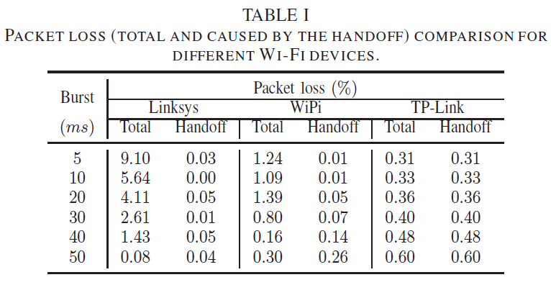
TESTS AND RESULTS
Burst (burst of beacons during the handoff)

Slide 16
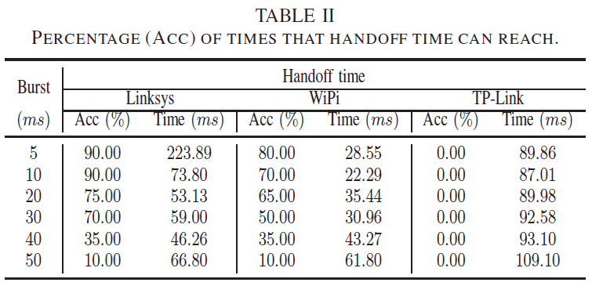
TESTS AND RESULTS
Acc (accumulative percentage)
Burst (burst of beacons during the handoff)

Slide 17
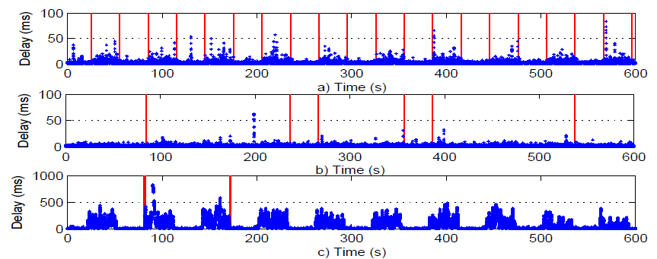
TESTS AND RESULTS

